Slide 1
2 in 1 -Washer Dryer
Subhanga Ghimire
”Quality is never an accident.It is an intention of skill execution and intelligent direction.

Slide 2
Menu
Tedious Washing
Dryer and Washer Set
Current Problem
Our Solution
Target Customer
Conclusion

Slide 3

TODAY’S TEDIOUS WASHING
Hours in Laundry
Laundry in dorm , apartment
63% Students have problem
45% Tenants
Hesen, Li, and Luo Ying. “Laundry Model, and Tried to Change and Solve the Status Quo and Problems of Laundry.

Slide 4
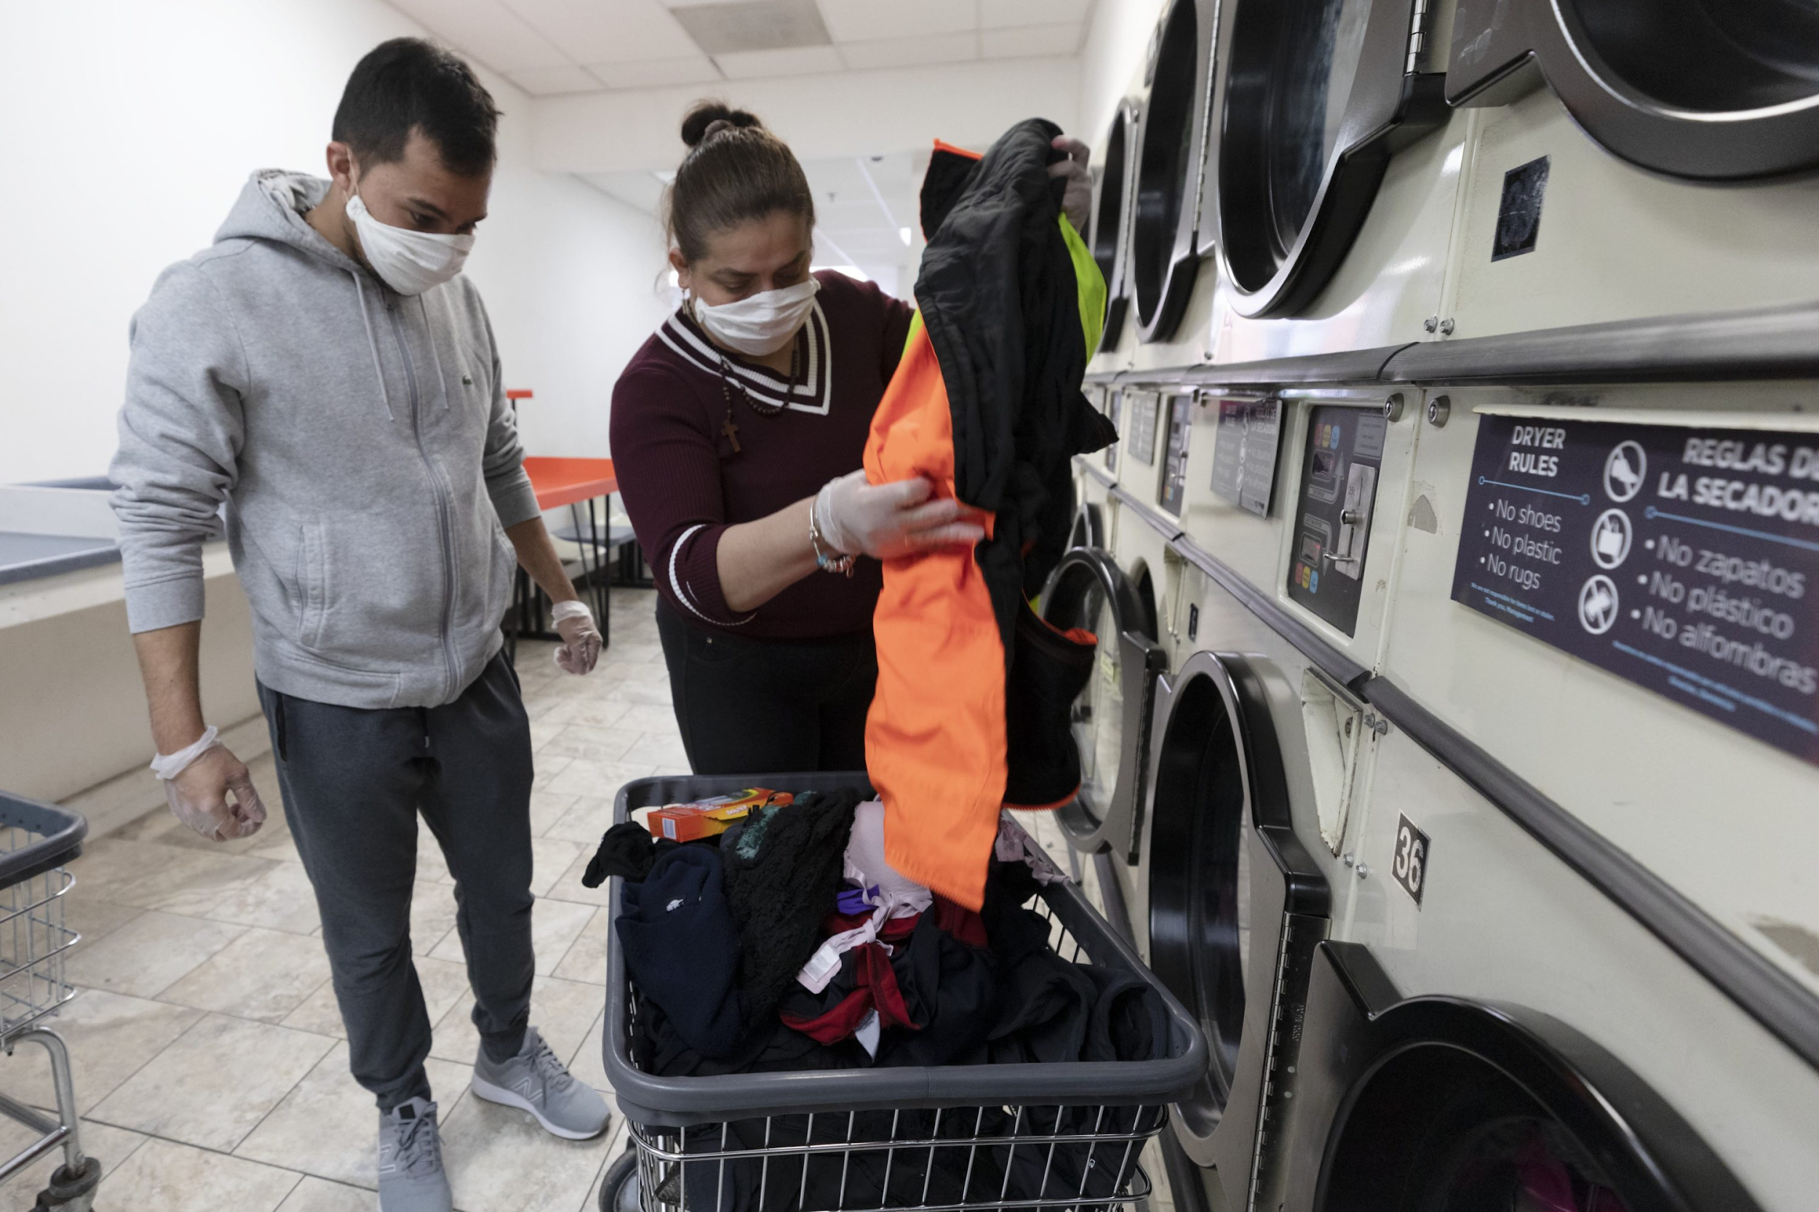
WHY “NHEC”
Budget Friendly($500 VS $2000)
Reliable(UV RAYS )
Convenient(IOT VS CHAIN)

Slide 5
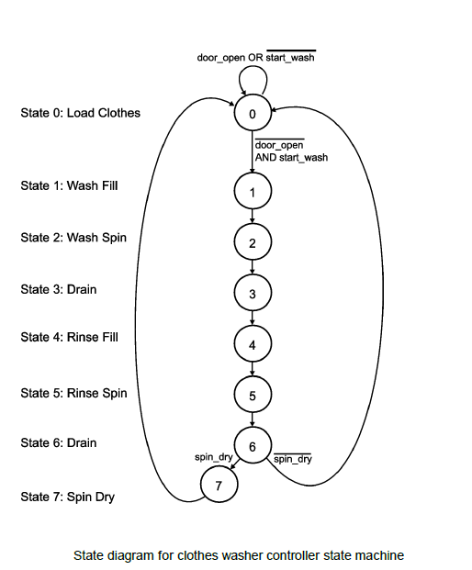
DRYER AND WASHER SET
Time Savings
Hassle Free
Cheaper

Slide 6
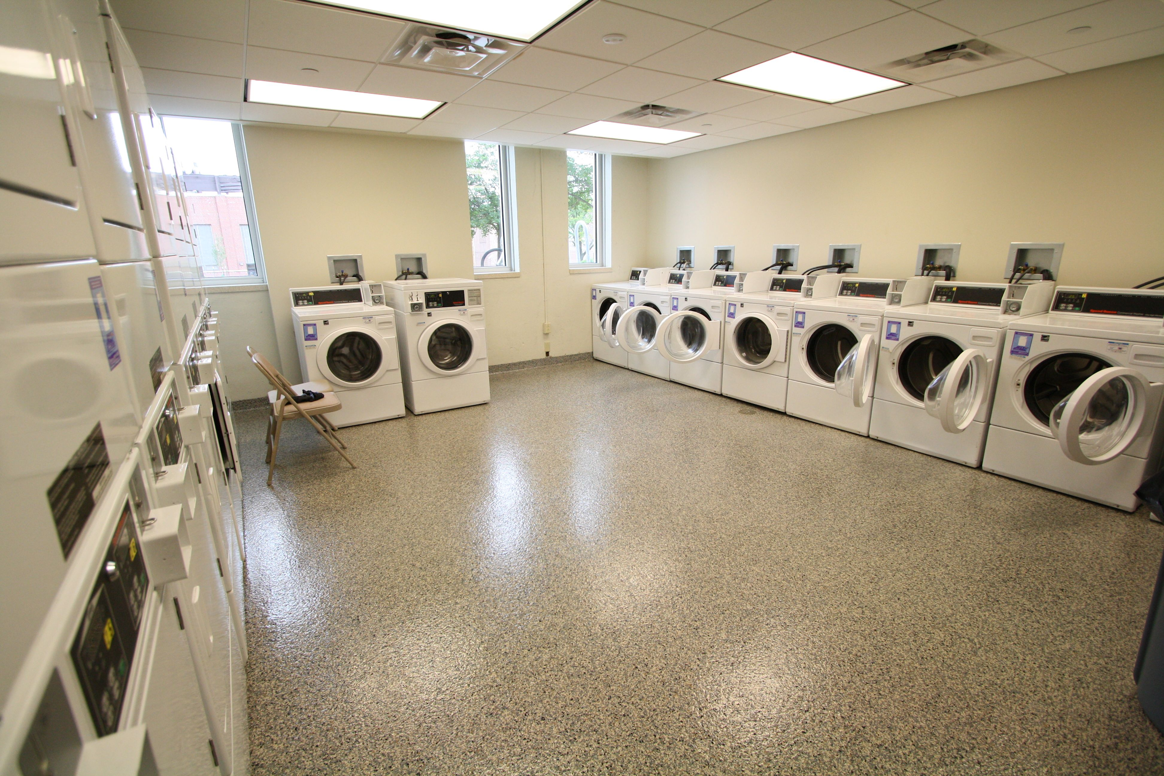
OUR TARGET CUSTOMERS
College Students
Apartment Residents
Laundromat

Slide 7
Thank you!
Do you have any questions?
subhanga.ghimire@valpo.edu
+2193075371
www.subhanga.com

